Slide 1
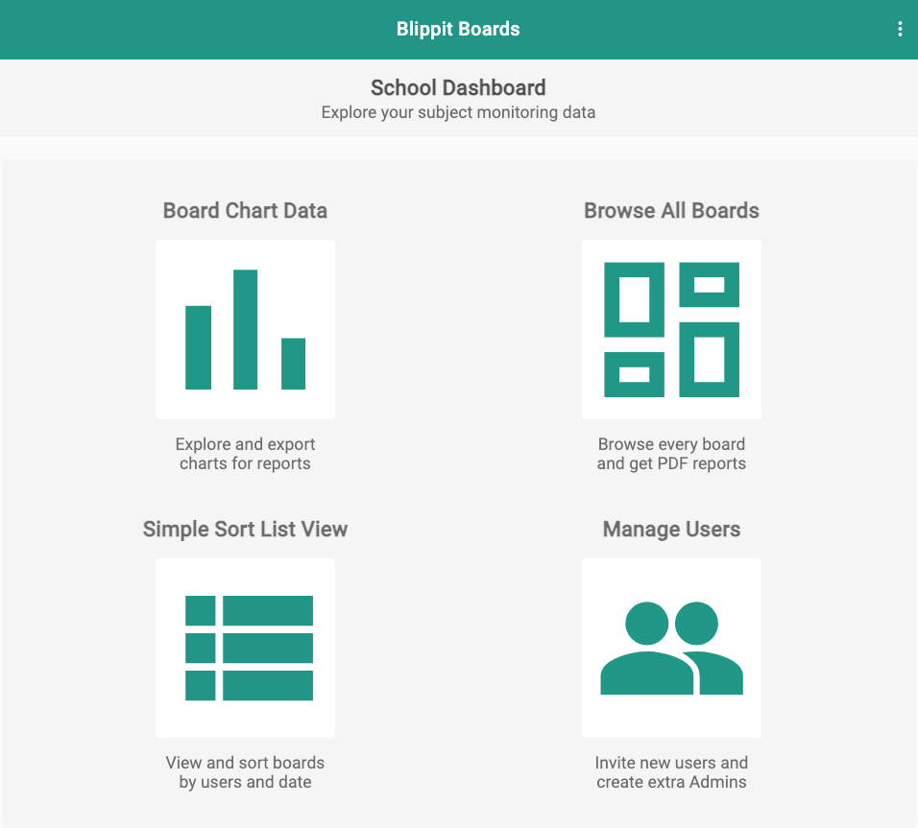
Some ideas of how dashboard charts can help you as a subject leader.
Log in at boards.blippit.app
to use your school dashboard

Slide 2
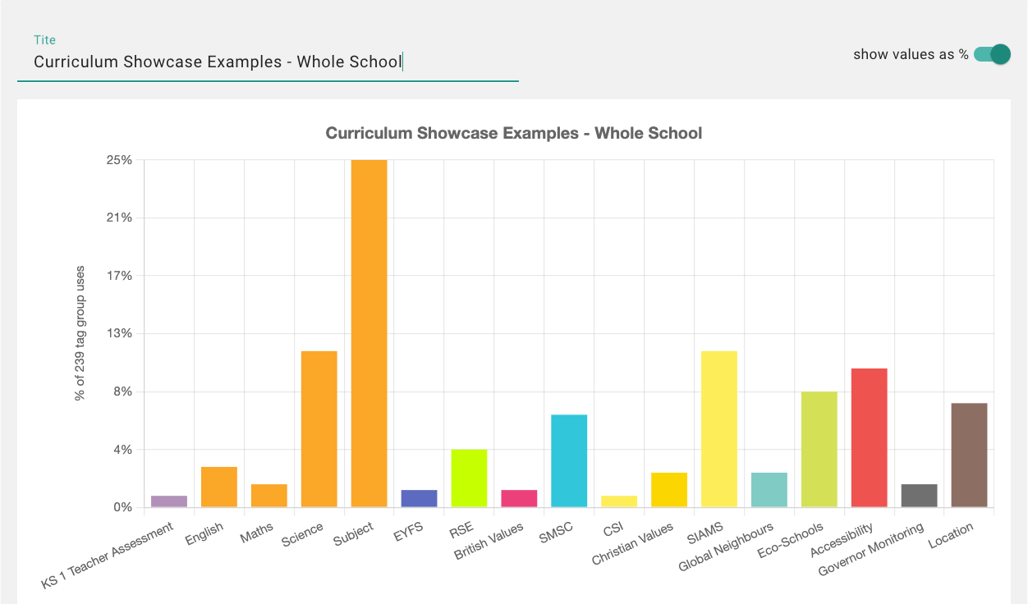
“I want to see and understand the balance of evidence that we have for the science curriculum throughout school.”
Blippit Boards Dashboard
Board Chart Data in the web dashboard
Set a date range if needed
See at a glance what the whole school has captured and tagged. Click the science chart segment to look more closely.
*Available Late Feb’24

Slide 3
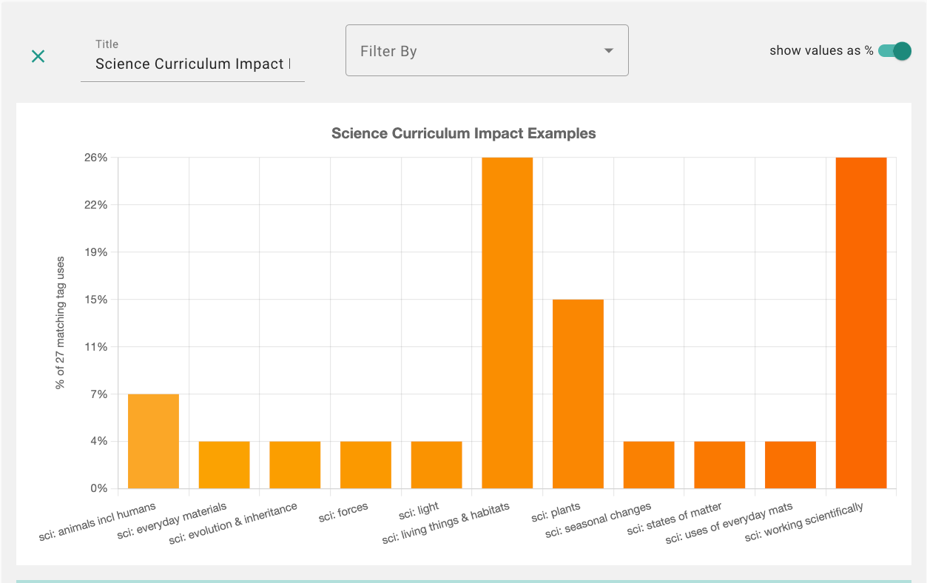
“I want to see and understand the balance of evidence that we have for the science curriculum throughout school.”
Blippit Boards Dashboard
Board Chart Data in the web dashboard
Set a date range if needed
The different aspects of science are shown for the whole school. Click any segment to see the specific evidence for that aspect.

Slide 4
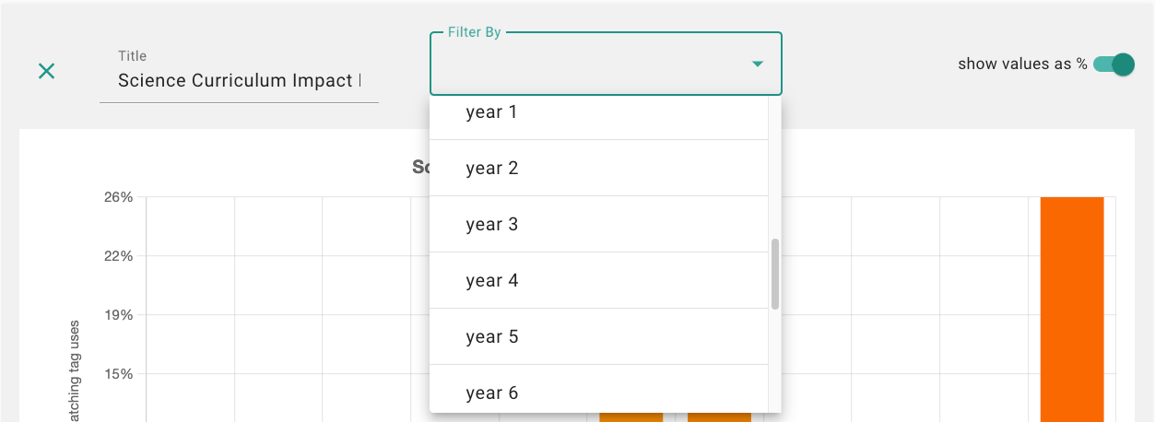
“How can I go deeper to see and understand the balance of science evidence that we have each year group and key stage?”
Blippit Boards Dashboard
Board Chart Data in the web dashboard
Set a date range if needed
Tap the filter to allow for year group and key stage science filtering.
With knowledge comes greater confidence and more informed next steps for action are now open to you as a subject leader.

Slide 5
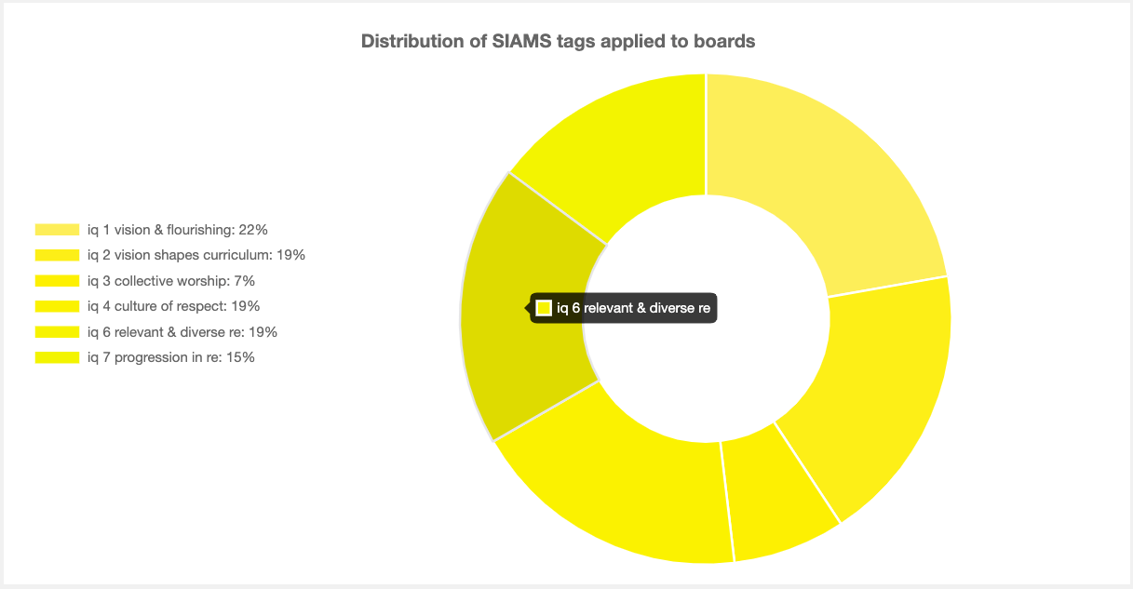
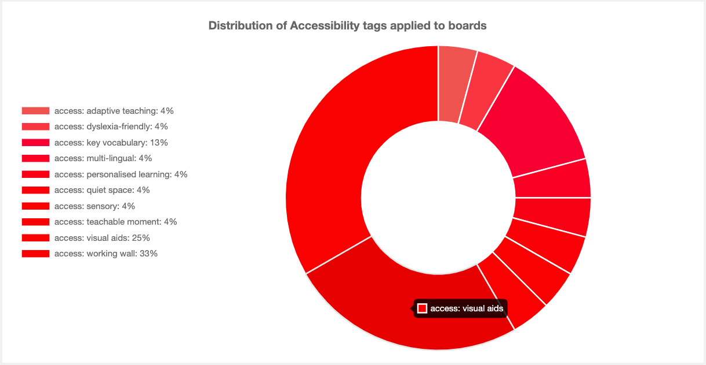
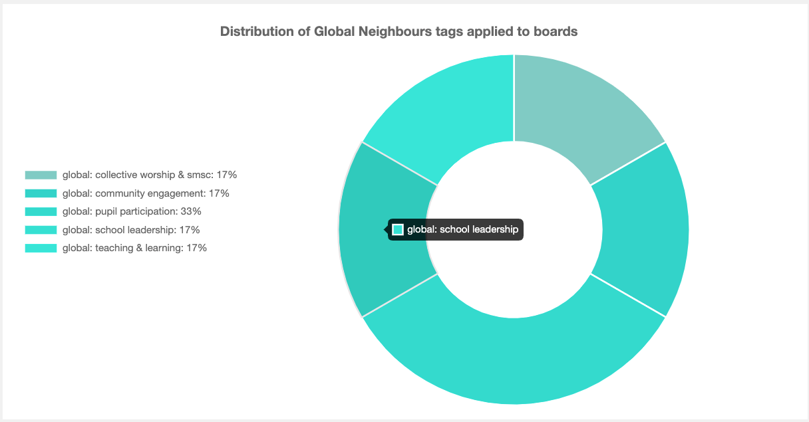
“Tap or click a chart segment to see the work for that focus area listed so you can report on it.”
Blippit Boards Dashboard
Board Chart Data in the web dashboard
Set a date range if needed
There’s a chart that will help inform your next steps whatever your subject area when colleagues tag boards.

Slide 6
Some ideas of how dashboard reports can help you as subject leader.
Log in at boards.blippit.app
to use your school dashboard

Slide 7
“I’d like a report containing all the secure examples of teacher-assessed writing in ks 1 that we have for the year for monitoring.”
Blippit Boards Dashboard
Browse all Boards in the web dashboard and Match All of these tags
Set a date range if needed
Tap or click to generate your report as a PDF or Word* file
*Available Late Feb’24

Slide 8
“I’d like to report on all examples of adaptive teaching in KS 2 that we have this year in any subject for my SEND monitoring.”
Blippit Boards Dashboard
Browse all Boards in the web dashboard and Match All of these tags
Set a date range if needed
Tap or click to generate your report as a PDF or Word* file
*Available Late Feb’24

Slide 9
“I’d like to report on any examples of Eco-Schools evidence for the whole school in any subject context.”
Blippit Boards Dashboard
Browse all Boards in the web dashboard. Tap Match Any of these tags
Set a date range if needed
Tap or click to generate your report as a PDF or Word* file
*Available Late Feb’24

Slide 10
“I’d like to report on any examples of working scientifically in science for KS 1.”
Blippit Boards Dashboard
Browse all Boards in the web dashboard. Tap Match All of these tags
Set a date range if needed
Tap or click to generate your report as a PDF or Word* file
*Available Late Feb’24

Slide 11
“I’d like to be able to support our ECT in year 4 with number functions. I need a report on what addition & subtraction and multiplication & division looks like for year 4 before we meet up.”
Blippit Boards Dashboard
Browse all Boards in the web dashboard. Tap Match All of these tags
Set a date range if needed
Tap or click to generate your report as a PDF or Word* file
*Available Late Feb’24

Slide 12
Blippit Boards
for Subject Leaders
blippitboards.com
Includes support for evidence gathering, monitoring & reporting on Eco-Schools, Global Neighbours, Forest School, SIAMS, SMSC, Learning Outside the Classroom & more.

