Slide 1
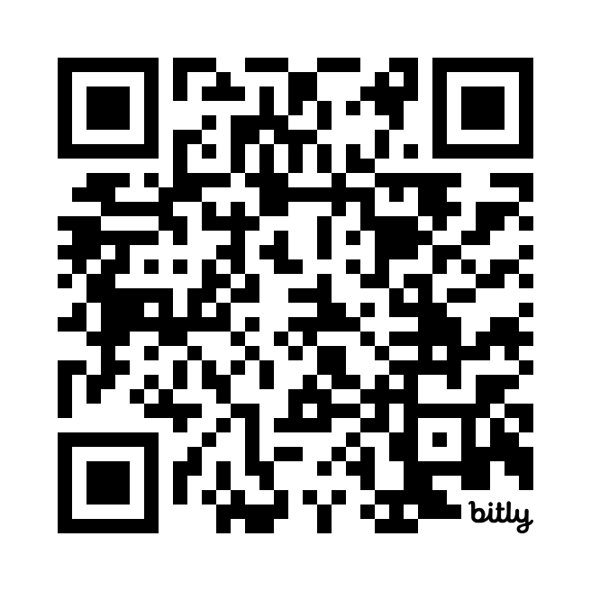
The concept
blippitboards.com
For online help & resources
bit.ly/blippitknowhow

Slide 2
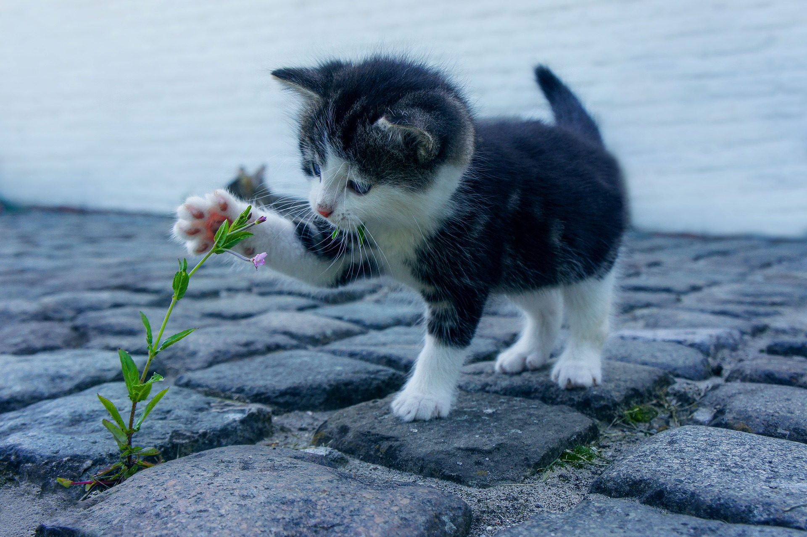
Tagging information helps us find almost everything
cute
kitten
carnivore
mammal
pet
flower
cat
fluffy

Slide 3
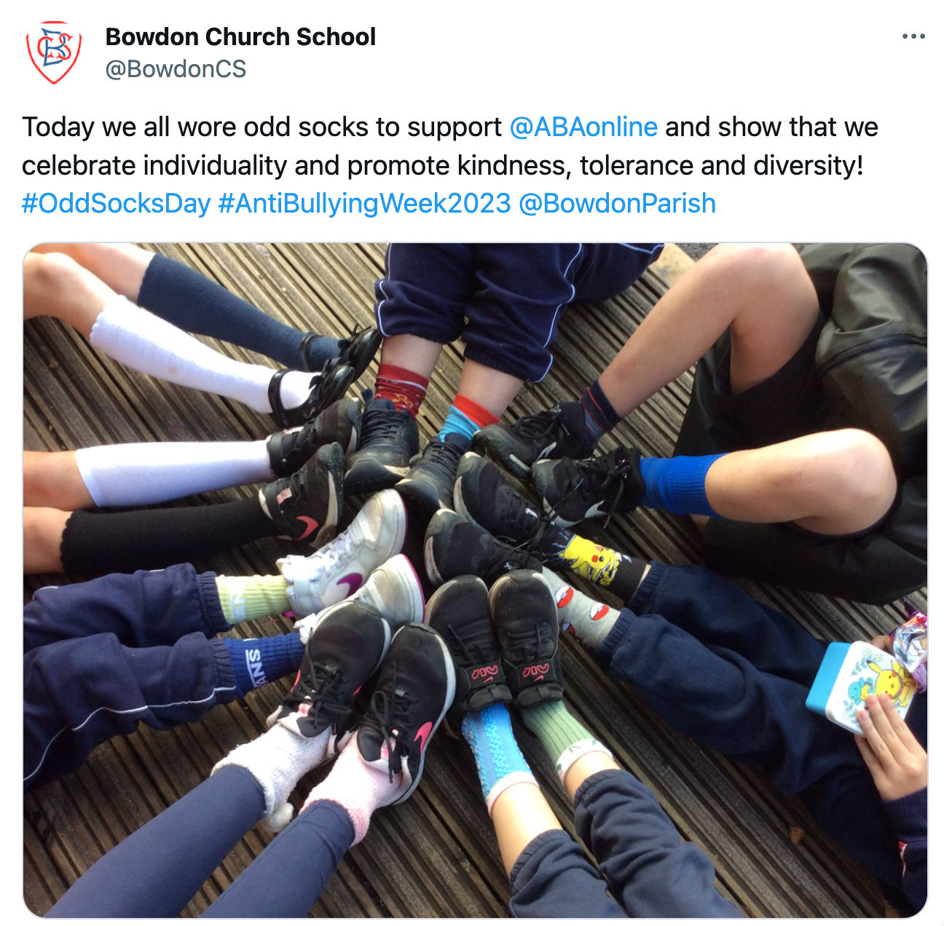
A bit like hashtags
#oddsocksday
#antibullyingweek2023

Slide 4
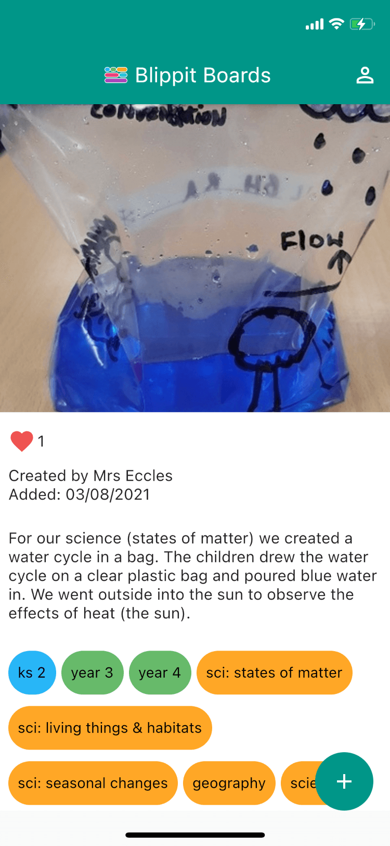
Blippit comes with ready-made tags for teachers to add to examples of work captured with the app

Slide 5
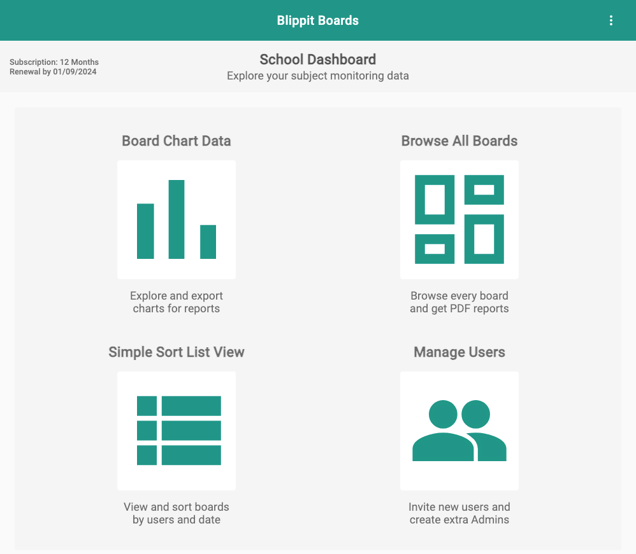
You use the app to
Add boards
Filter the
timeline
&
Tag boards
You use the dashboard to
See Charts
Filter the
timeline
Add
users
&
&
Get Reports

Slide 6
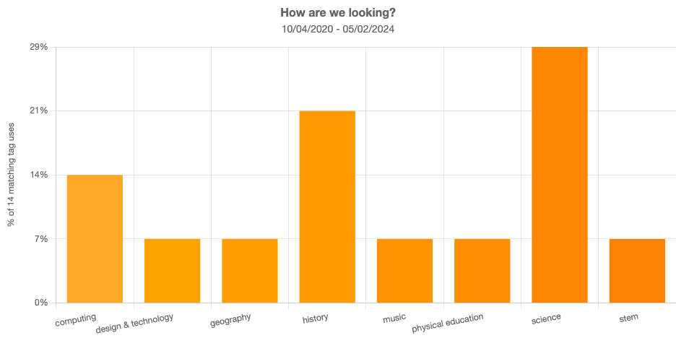
Blippit’s tags help everyone to…
Filter & find work instantly
Get custom reports & charts*
*Use the web dashboard at boards.blippit.app
(Google Chrome on laptop or Safari on iPad)

Slide 7
Log in
Register the school at
boards.blippit.app/sign-up
Whoever registers the school can add other users and email invites are sent out with a link to confirm.
Click forgotten password if an email link expires.
For online help & resources
bit.ly/blippitknowhow

