Slide 1
What curriculum areas can I tag with Blippit Boards?
Register for a trial or log in to your dashboard via blippitboards.com
to use your school dashboard

Slide 2
Blippit comes with 21 ready-made tag categories
Register for a trial or log in to your dashboard via blippitboards.com
to use your school dashboard

Slide 3
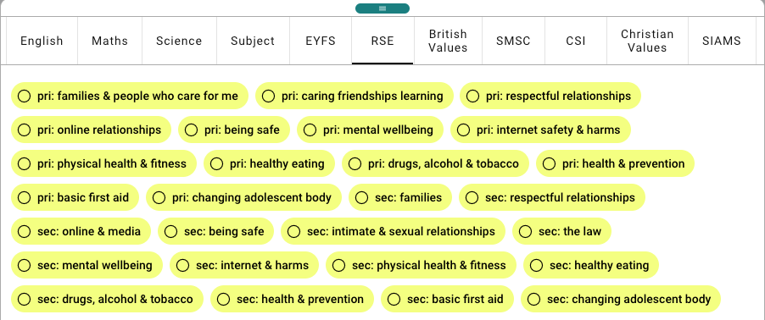
These are all managed centrally by Blippit.
Register for a trial or log in to your dashboard via blippitboards.com
to use your school dashboard

Slide 4
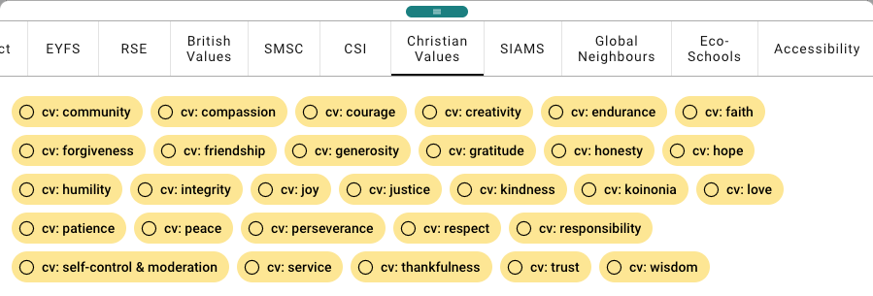
Teachers tap tags for their evidence.
Register for a trial or log in to your dashboard via blippitboards.com
to use your school dashboard

Slide 5
Hide the categories you don’t want to see or use
Register for a trial or log in to your dashboard via blippitboards.com
to use your school dashboard

Slide 6
Custom tags can be added on the fly for less common usage
Register for a trial or log in to your dashboard via blippitboards.com
to use your school dashboard

Slide 7
You can have bespoke tag categories created just for your school too!
Go bespoke!
A one-off cost is associated with each bespoke tag category.
Small school £35
Primary school £45
Secondary School £60
(Prices correct as of 2/4/24)
Register for a trial or log in to your dashboard via blippitboards.com
to use your school dashboard

Slide 8
Blippit Boards
for Subject Leaders
Includes support for evidence gathering, monitoring & reporting on Eco-Schools, Global Neighbours, Forest School, SIAMS, SMSC, Learning Outside the Classroom & more.
blippitboards.com

